Slide 1
Precision Oncology - using Genomics, Proteomics and Imaging to inform biology and treatment
Warren Kibbe, PhD
warren.kibbe@nih.gov
@wakibbe
April 26th, 2017

Slide 2
Background
Data in Biomedicine
Data Sharing
Data Commons
Genomics and Computation
Thanks to many folks for slides, but especially Jerry Lee
Notes:
Address Standards, Accessibility, and Security

Slide 3
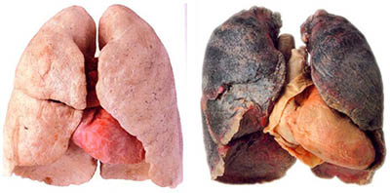
In 2016 there were an estimated
1,700,000 new cancer cases
and
600,000 cancer deaths
- American Cancer Society
Cancer remains the second most common cause of death in the U.S.
- Centers for Disease Control and Prevention

Slide 5
In 2016 there were an estimated
15,500,000
cancer survivors in the U. S.

Slide 6

Understanding Cancer
Precision medicine will lead to fundamental understanding of the complex interplay between genetics, epigenetics, nutrition, environment and clinical presentation and direct effective, evidence-based prevention and treatment.

Slide 7
Cancer is a grand challenge
Requires:
Deep biological understanding
Advances in scientific methods
Advances in instrumentation
Advances in technology
Data and computation
Cancer Research and Care generate
detailed data that is critical to
create a learning health system for cancer

Slide 8


Slide 9
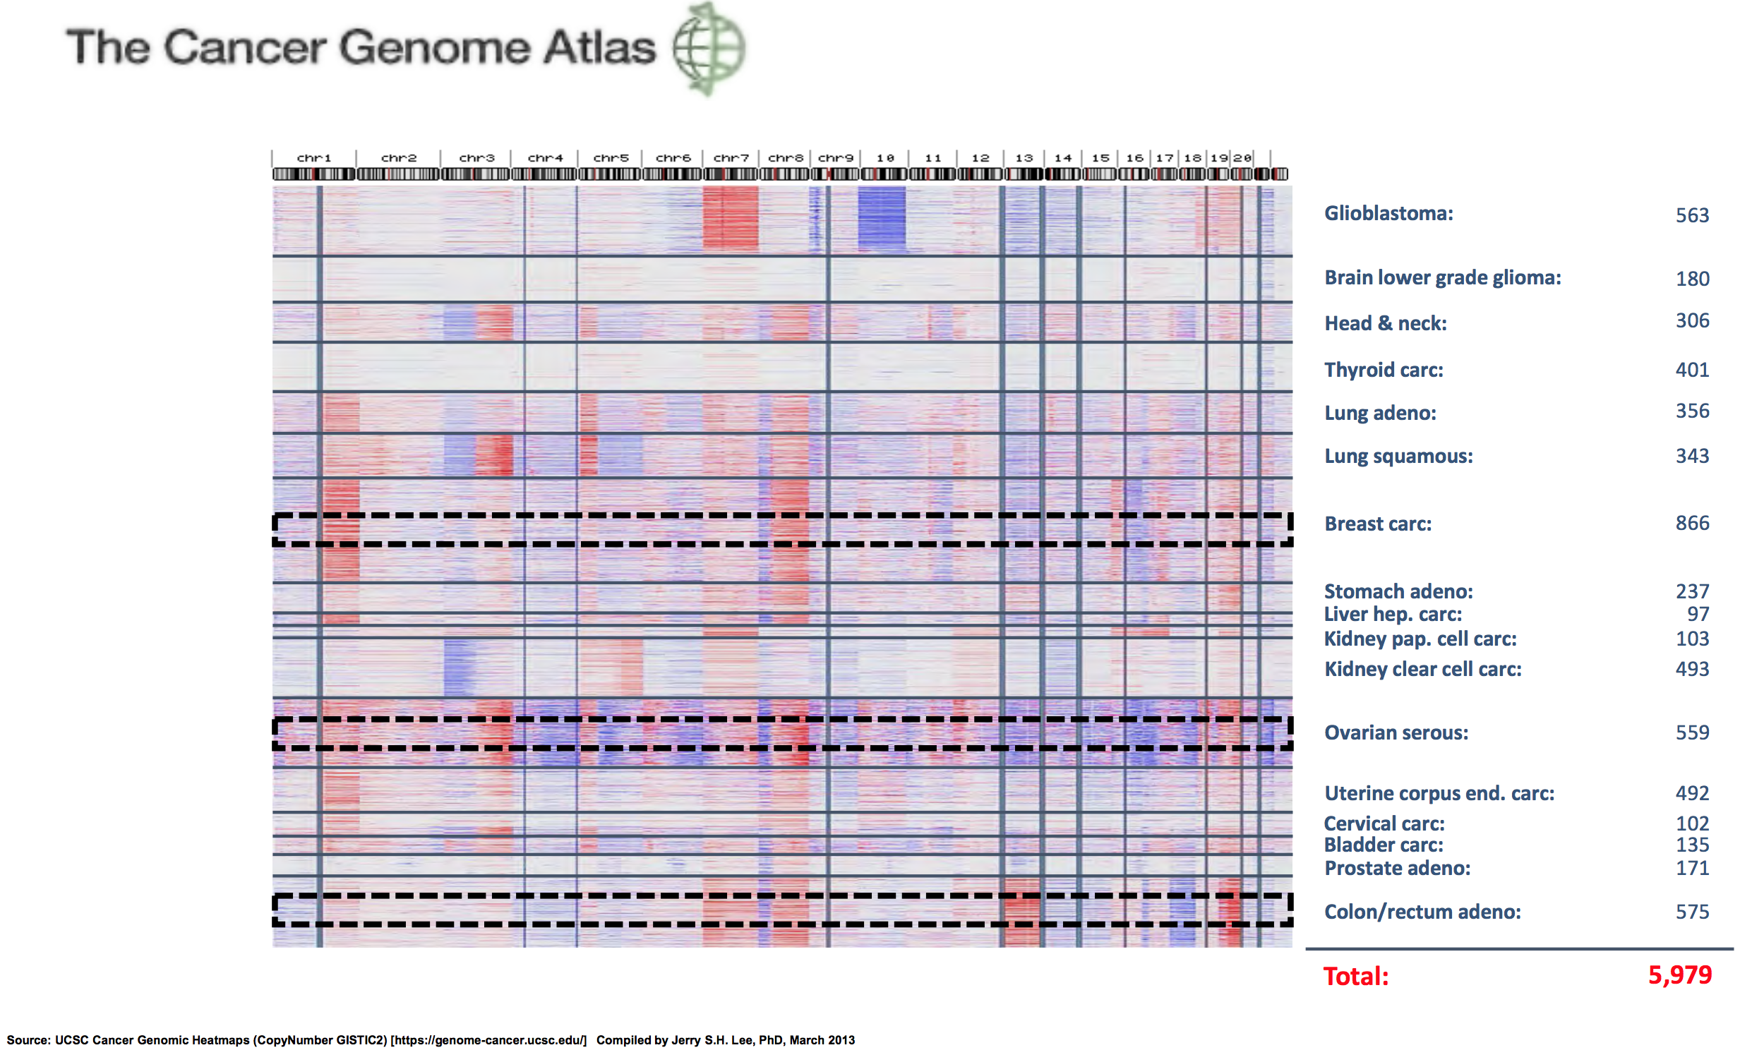

Slide 10
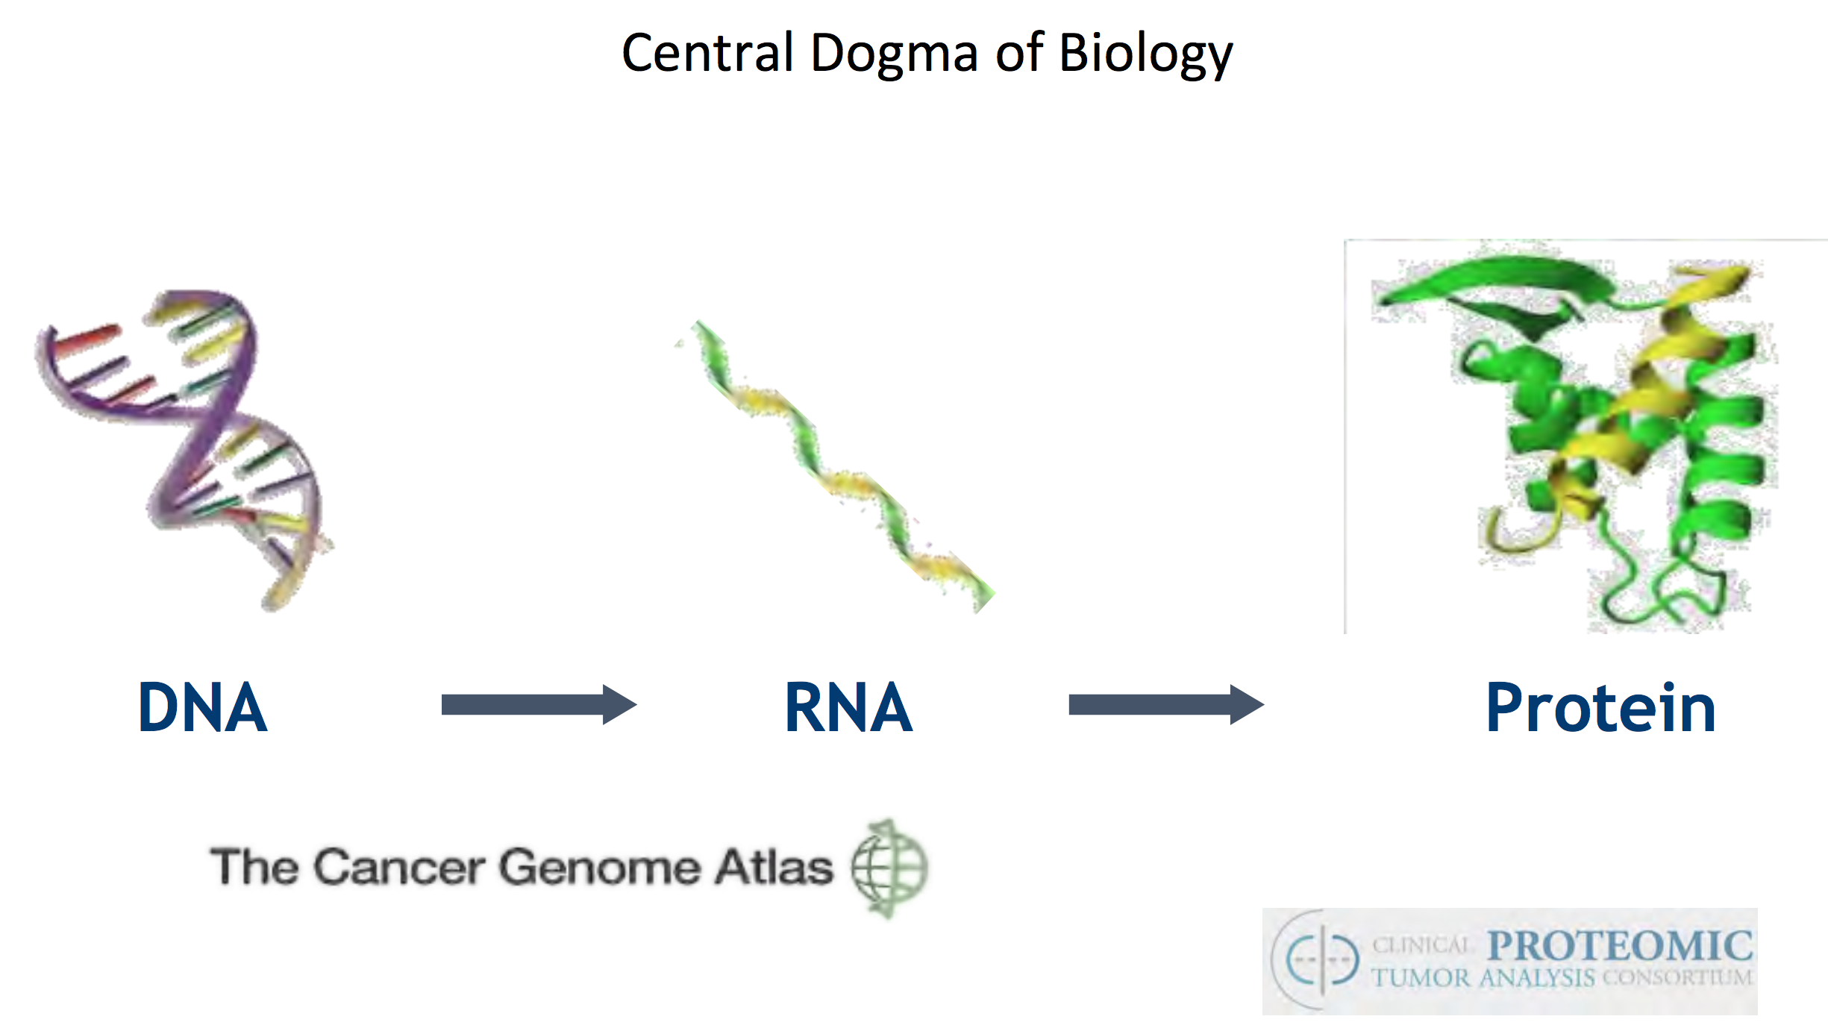

Slide 11
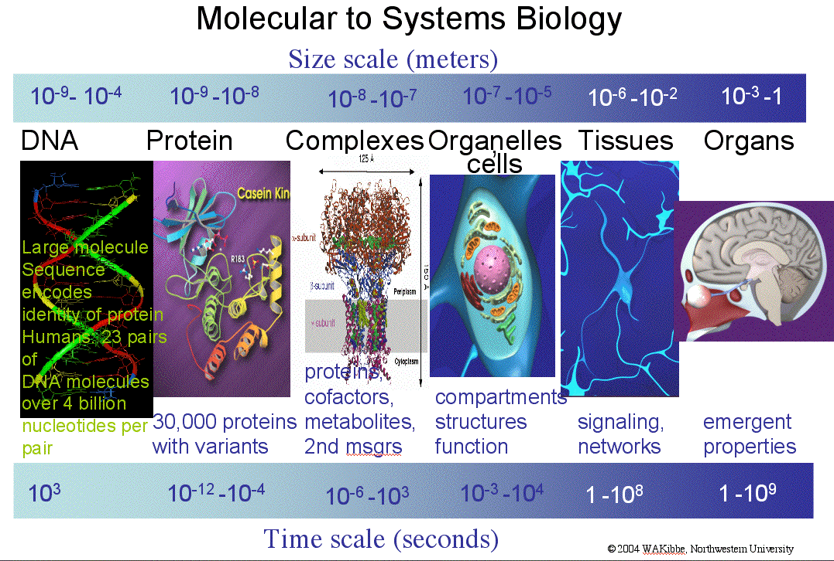
Biological Scales

Slide 12

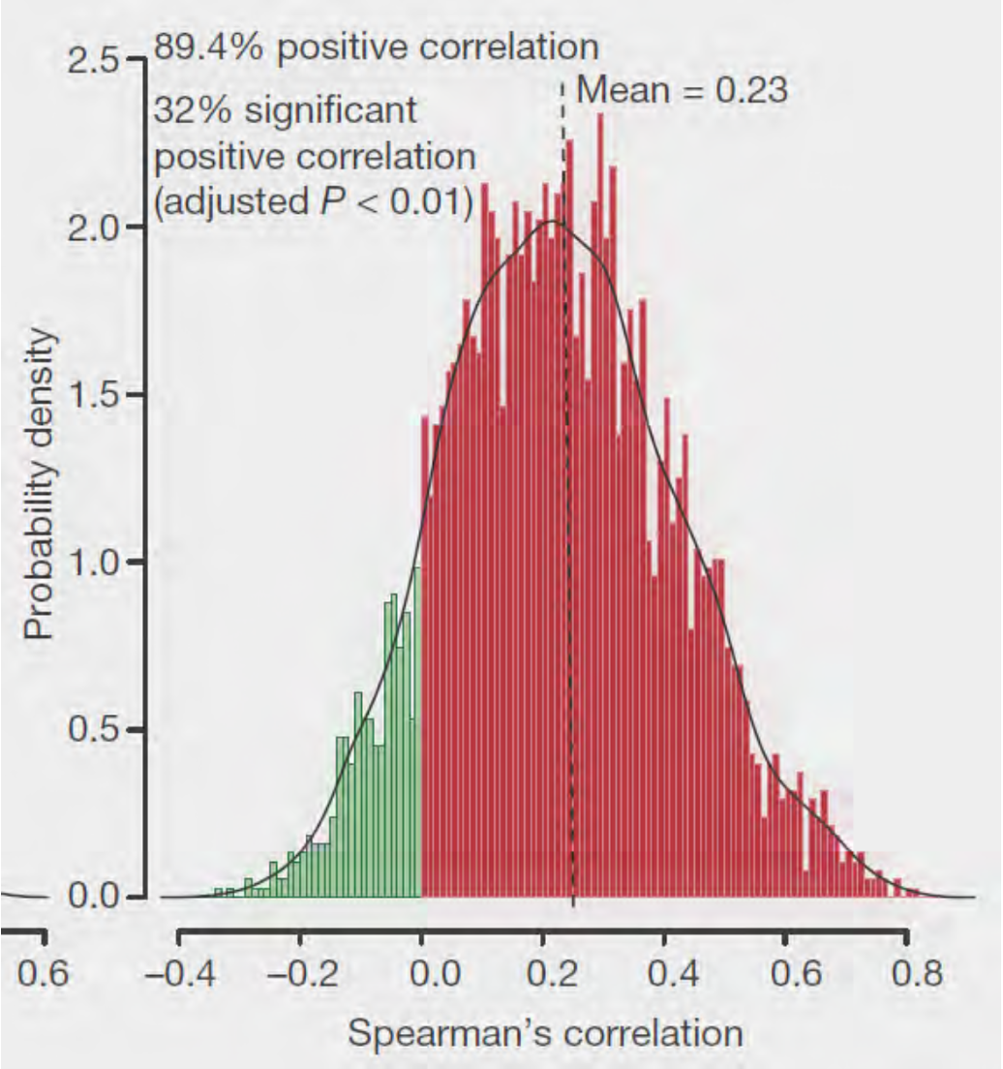
Keeping in mind cellular dynamics
On average across 375 tumor samples, ONLY 33% of RNA expression differences correlated with protein abundance
Zhang B et al, Proteogenomic characterization of human colon and rectal cancer, Nature, 2014, July 20.

Slide 13
Genomics is the beginning of precision medicine, not the end!

Slide 14
Digital technology is changing rapidly

Slide 15
Cancer therapy is changing

Slide 16
Application of Cancer Genomics is changing

Slide 17
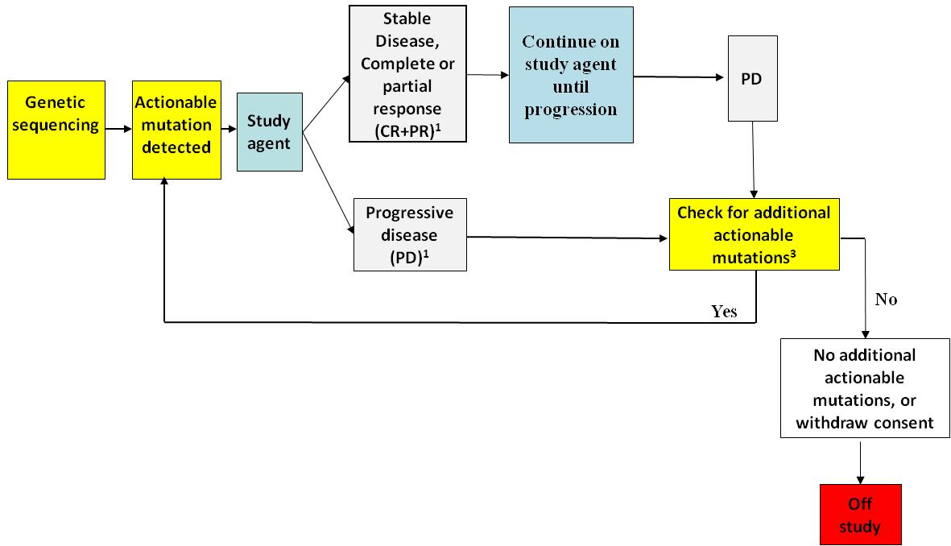
NCI MATCH
,2
¹CR, PR, SD, and PD as defined by RECIST
²Stable disease is assessed relative to tumor status at re-initiation of study agent
³Rebiopsy; if additional mutations, offer new targeted therapy
Conduct across 2400 NCI-supported sites
Pay for on-study and at progression biopsies
Screen 5000 patients to complete
30 phase II trials; target 25% ‘rare’ tumors;

Slide 18
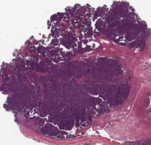
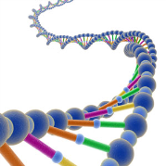
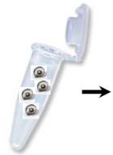
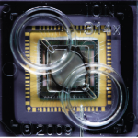

MATCH Assay: Workflow for 12-14 Day Turnaround
Biopsy Received at Quality Control Center
Tissue Fixation
Path Review
Tumor content >70%
3-5 DAYS
1 DAY
Nucleic Acid
Extraction
DNA/RNA yields >20 ng
Library/Template Prep
Library yield >20 pM
1 DAY
Test fragments
Total read
Reads per BC
Coverage
NTC, Positive, Negative Controls
1 DAY
Sequencing , QC Checks
1 DAY
Centralized Data Analysis
aMOIs Identified
Clinical Laboratory aMOI Verification
3 DAYS
10-12 days
Rules Engine Treatment Selection

Slide 19
NCI MATCH Arms – 1-10
Arm | Target | Drug(s)
A | EGFR mut | Afatinib
B | HER2 mut | Afatinib
C1 | MET amp | Crizotinib
C2 | MET ex 14 sk | Crizotinib
E | EGFR T790M | AZD9291
Arm | Target | Drug(s)
F | ALK transloc | Crizotinib
G | ROS1 transloc | Crizotinib
H | BRAF V600 | Dabrafenib+trametinib
I | PIK3CA mut | Taselisib
J | HER2 amp | Trastuzumab+pertuzumab

Slide 20
NCI MATCH Arms – 11-20
Arm | Target | Drug(s)
L | mTOR mut | TAK-228 (formerly MLN0128)
M | TSC1 or TSC2 mut | TAK-228 (formerly MLN0128)
N | PTEN mut | GSK2636771
P | PTEN loss | GSK2636771
Q | HER 2 amp | Ado-trastuzumab emtansine
Arm | Target | Drug(s)
R | BRAF nonV600 | Trametinib
S1 | NF1 mut | Trametinib
S2 | GNAQ/GNA11 | Trametinib
T | SMO/PTCH1 | Vismodegib
U | NF2 loss | Defactinib

Slide 21
NCI MATCH Arms – 21-30
Arm | Target | Drug(s)
V | cKIT mut | Sunitinib
W | FGFR1/2/3 | AZD 4547
X | DDR2 mut | Dasatinib
Y | AKT1 mut | AZD 5363
Z1A | NRAS mut | Binimetinib
Arm | Target | Drug(s)
Z1B | CCND1,2,3 amp | Palbociclib
Z1C | CDK4 or CDK6 amp | Palbociclib
Z1D | dMMR | Nivolumab
Z1E | NTRK fusions | Larotectinib (LOXO-101)
Z1I | BRCA1 or BRCA2 mut | AZD1775

Slide 22
MATCH Observations
MATCH is open at ~1500 NCORP and NCTN sites
Accrual has been 100-150 patients / week
On study rate was initially ~8% for first 8 arms
After reopening May 30, 2016 rate has been ≥20% for 20+ arms
Processing has been holding to 12-14 days average
Interest has been high

Slide 23
Precision Oncology
It isn’t just about matching patients to therapy, it is also about avoiding therapies that will not work.
Biology is complex, and we still have a lot of basic biology to understand
Genomics+imaging+clinical labs+phenotyping is the first wave of precision oncology

Slide 24
Nature of Science is changing
Scale
Precision
Complexity
Opportunity

Slide 25
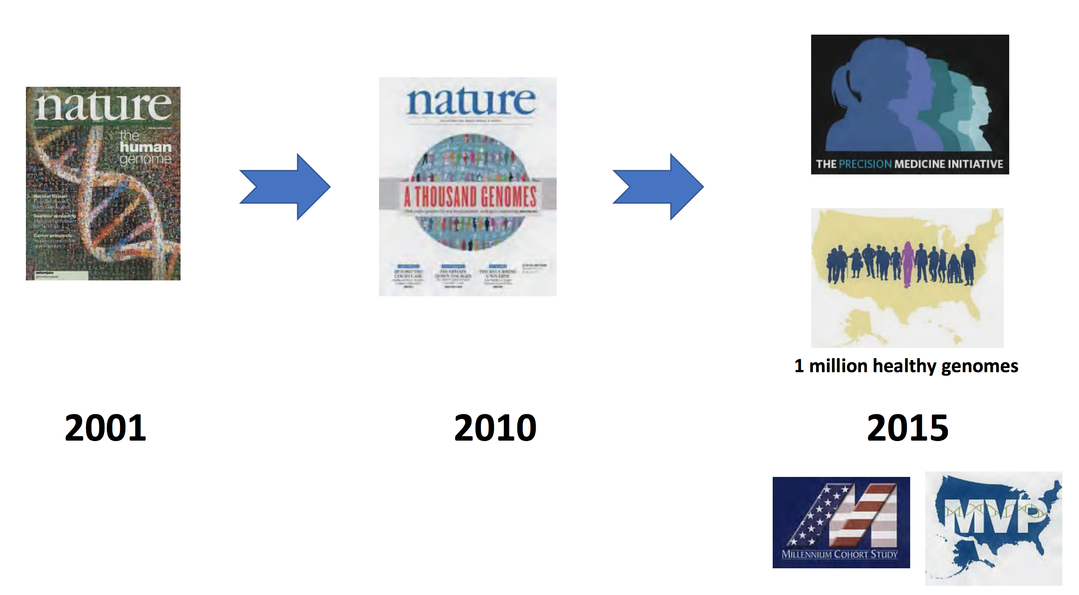
Notes:
The scale of genomics, population science and data science is dramatically changing!

Slide 26
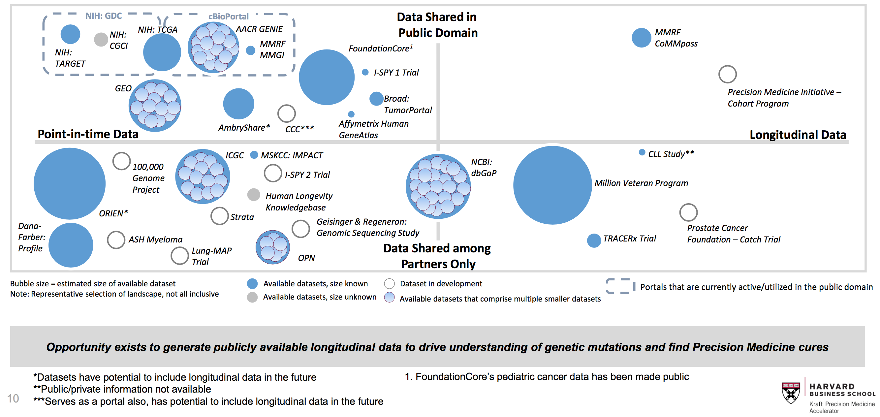
June 2016

Slide 27
Biology and Medicine are now data intensive enterprises
Scale is rapidly changing
Technology, data, computing and IT are pervasive in the lab, the clinic, in the home, and across the population

Slide 28
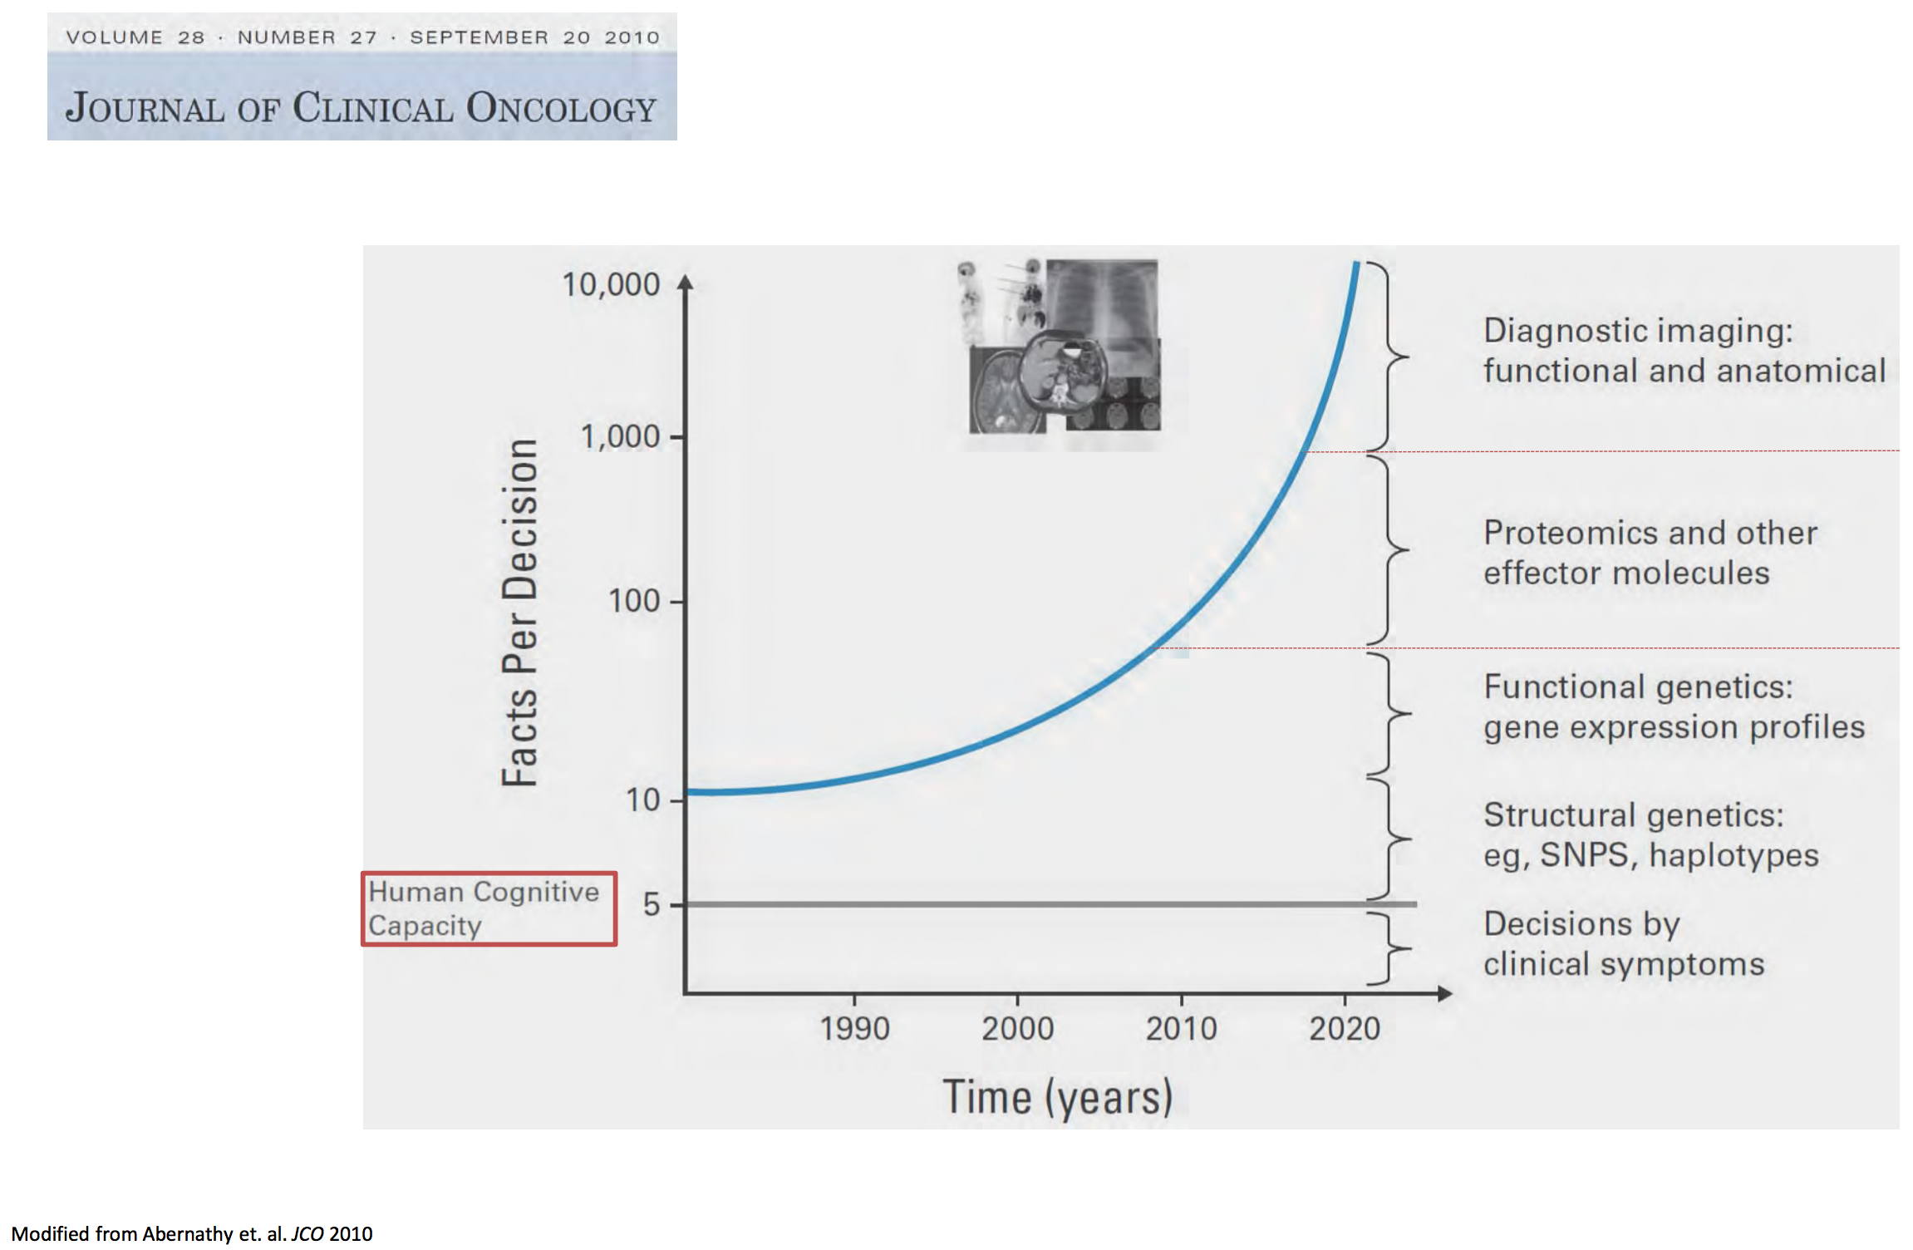
Notes:
But people can make effective decisions on the same number of factors…

Slide 29
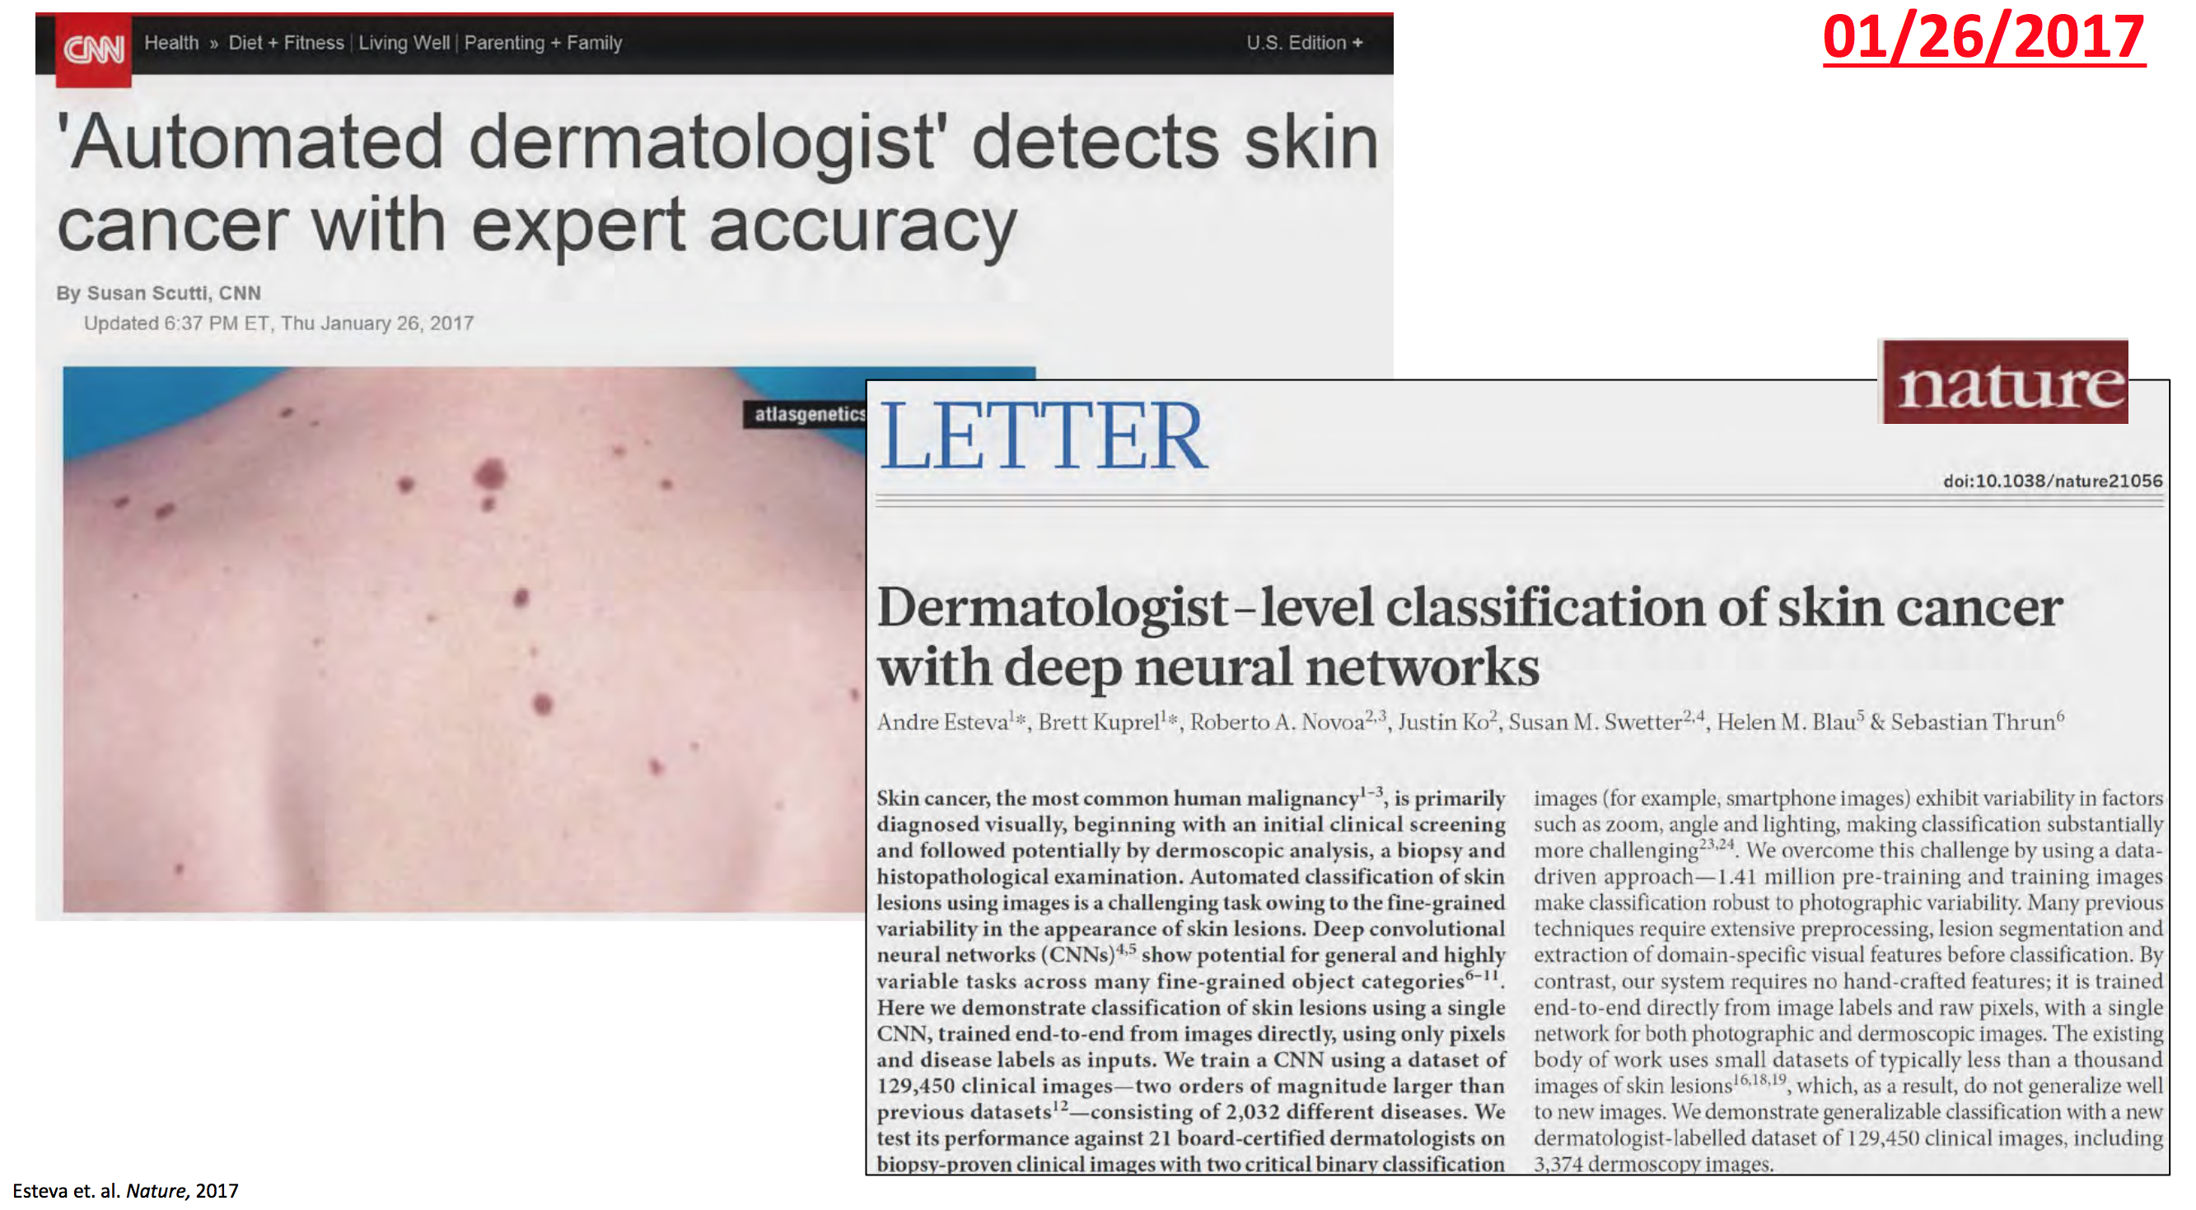
Sebastian Thrun
Notes:
How can we use machine learning and other techniques to reduce cognitive overload?

Slide 30
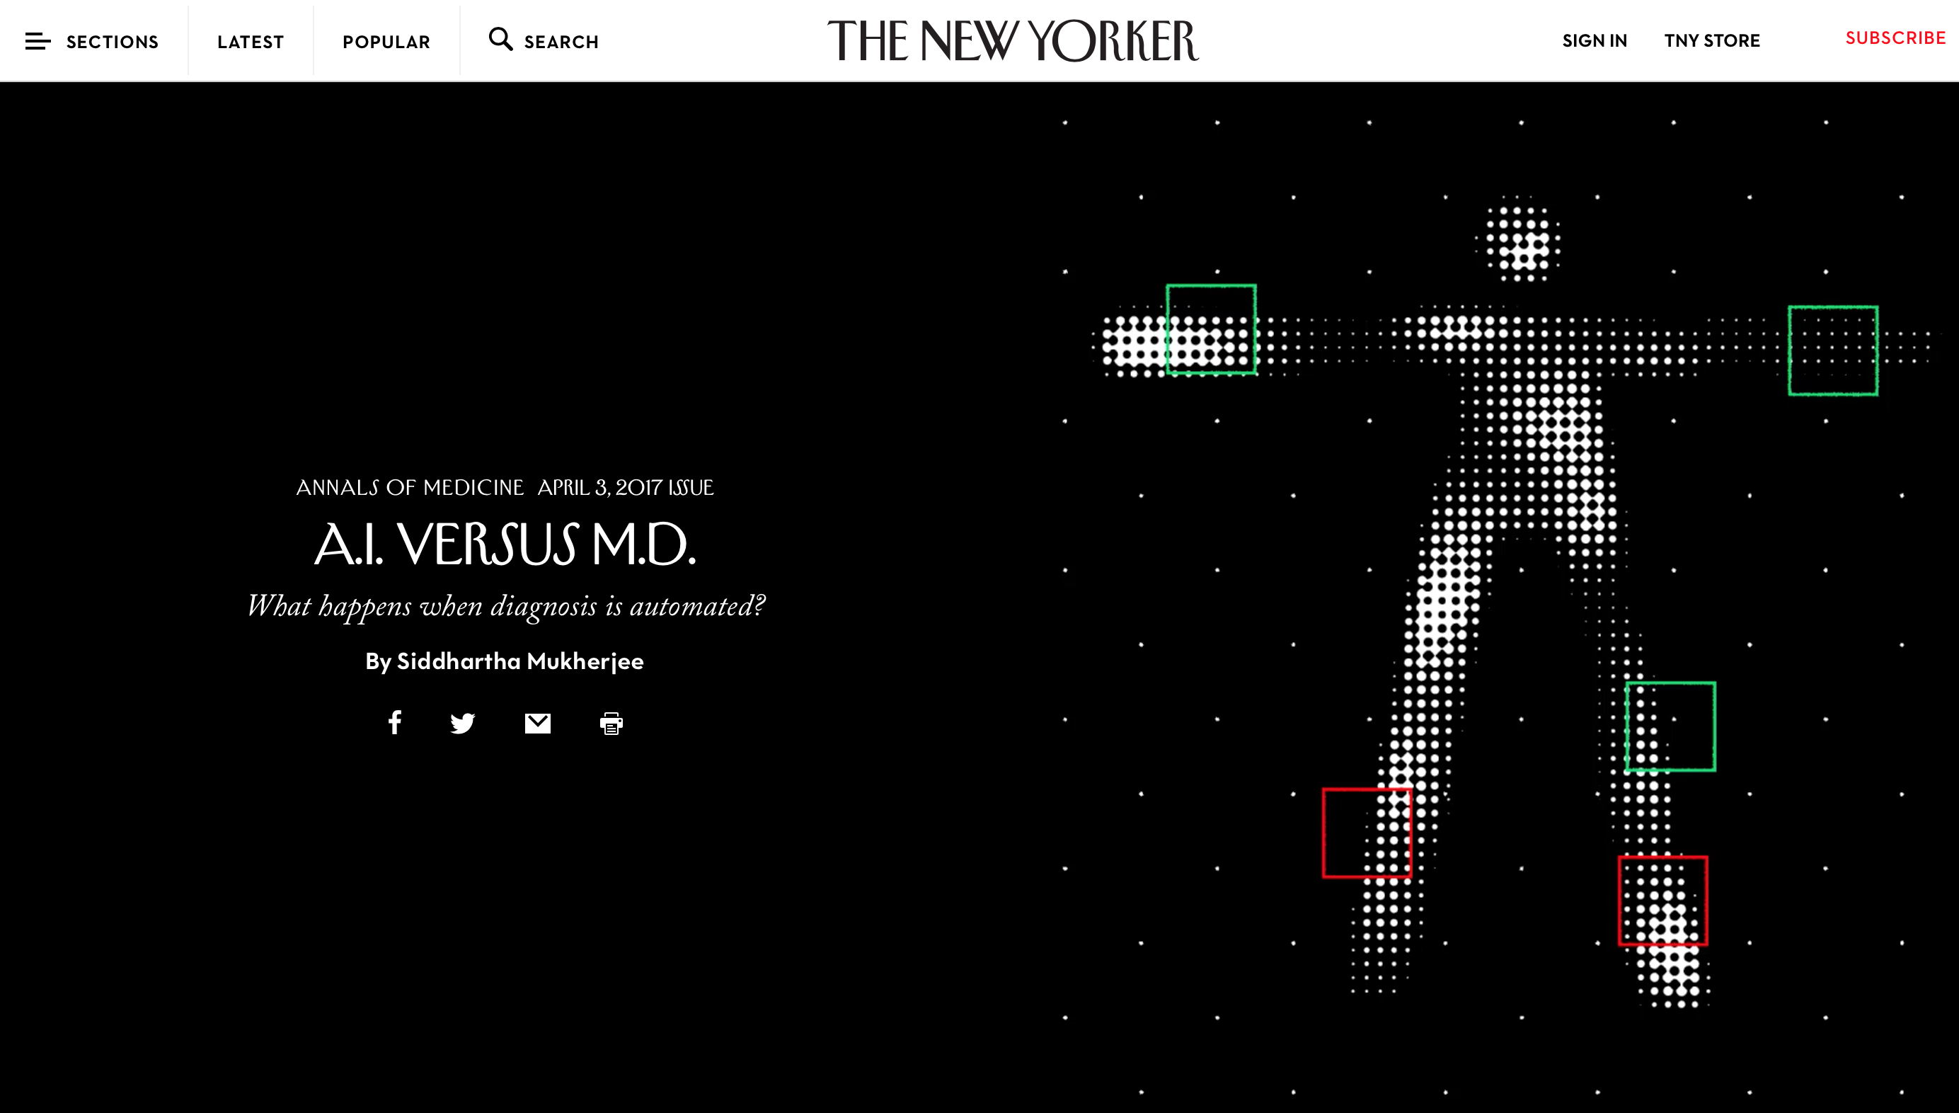

Slide 31
“...an advantage of machine learning is that it can be used even in cases where it is infeasible or difficult to write down explicit rules to solve a problem...”
https://www.whitehouse.gov/sites/default/files/whitehouse_files/microsites/ostp/NSTC/preparing_for_the_future_of_ai.pdf

Slide 32
Expert Systems vs Machine Learning
In 1945, the British philosopher Gilbert Ryle identified two kinds of knowledge— factual, propositional knowledge that can be ordered into rules—“knowing that.” versus implicit, experiential, skill-based—“knowing how.”
Machine Learning is based on ‘learning how’. Expert systems, or rule based machines, are based on ‘knowing that’.

Slide 33
Human Cognition
Three kinds of learning:
Learning that – rule-based knowledge
Learning how – experiential knowledge
Learning why – integrative, explanatory knowledge

Slide 34


Slide 35


Slide 36
" there is great potential for new insights to come from the combined analysis of cancer proteomic and genomic data, as proteomic data can now reproducibly provide information about protein levels and activities that are difficult or impossible to infer from genomic data alone ”
Douglas R. Lowy, MD
Acting Director of the National Cancer Institute, National Institutes of Health
5/25/2016

Slide 37
Genomics is the beginning of precision medicine, not the end!

Slide 38
Plumbing, architecture, genomics

Slide 39

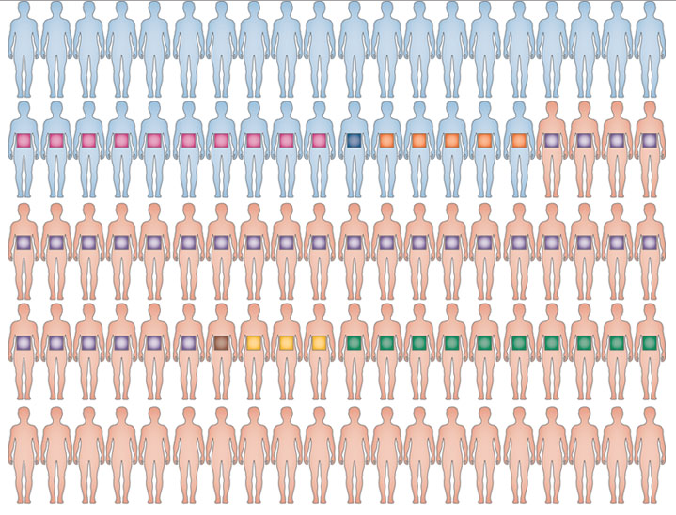
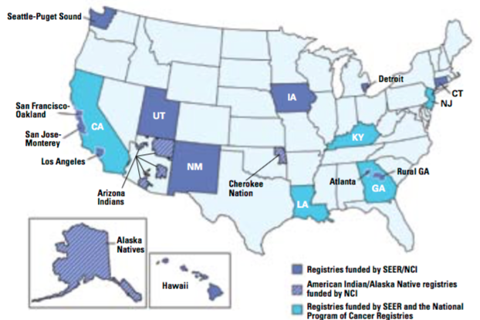
Cancer Research Data Ecosystem – Cancer Moonshot BRP
Surveillance
Big Data
Implementation research
Patient engaged
Research
Discovery
Proteogenomics
Imaging data
Clinical trials
EHR, Lab Data, Imaging,
PROs, Smart Devices,
Decision Support
Clinical Research
Observational studies
Well characterized research data sets
Cancer cohorts
Patient data
GDC
SEER
Research information
donor
Active research
participation
Learning from every
cancer patient

Slide 40
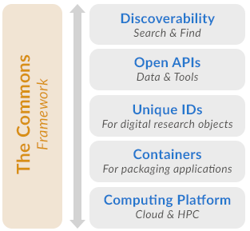
Data Commons Framework

Slide 41


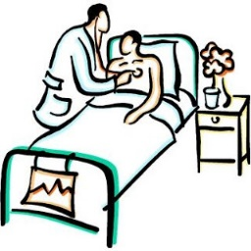

Data Commons Structure
NCI Thesaurus
caDSR
NLM UMLS
RxNorm
LOINC
SNOMED
Researchers
Institutions
Clinicians
Patients
Data Contributors and Consumers

Slide 42
Cancer Data Sharing
& Data Commons
Support open science
Support data reusability
Aligned with Cancer Moonshot
Part of Precision Medicine
Aligned with FAIR principles
Reduce Health Disparities
Improve patient access to clinical trials
Support a National Cancer Data Ecosystem
Reduce the risk, improve early detection, outcomes and survivorship in cancer

Slide 43
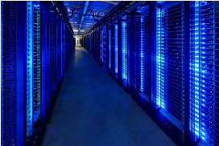
Changing the conversation around data sharing
NIH Data Commons
NCI Genomic Data Commons
National Cancer Data Ecosystem
How do we find data, software, standards?
How can we make data, annotations, software, metadata accessible?
How do we reuse data standards?
How do we make more data machine readable? Sustainable?
Data Commons co-locate data, storage and computing infrastructure, and frequently used tools for analyzing and sharing data to create an interoperable resource for the research community.
*Robert L. Grossman, Allison Heath, Mark Murphy, Maria Patterson, A Case for Data Commons Towards Data Science as a Service, to appear. Source of image: Interior of one of Google’s Data Center, www.google.com/about/datacenters/.

Slide 44
GDC as an example of a new architecture for storing and sharing cancer data

Slide 45
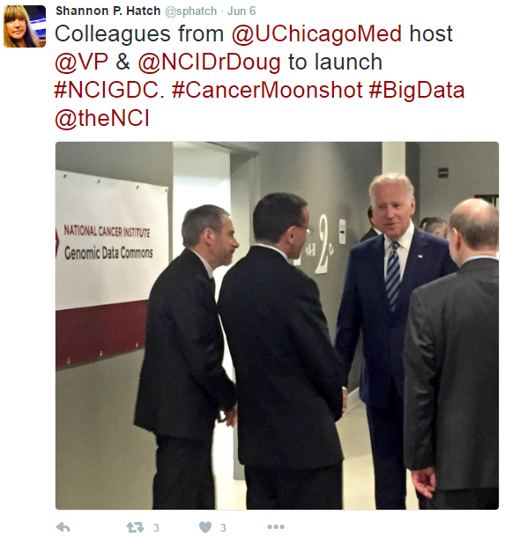
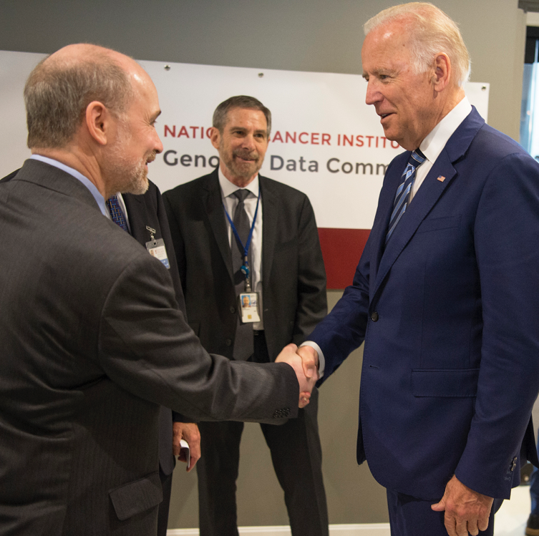
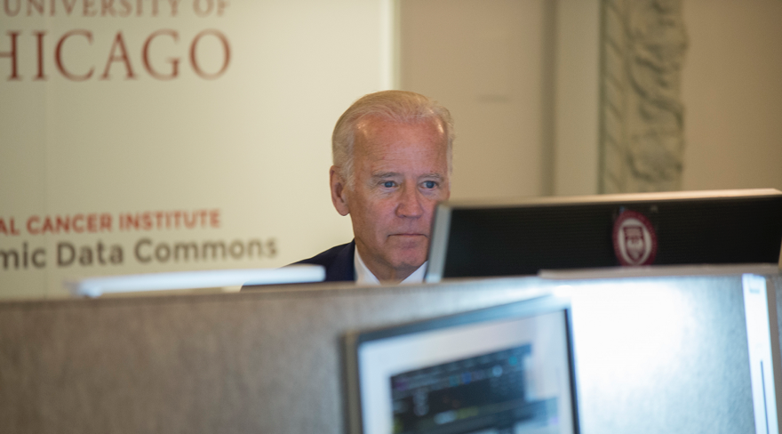
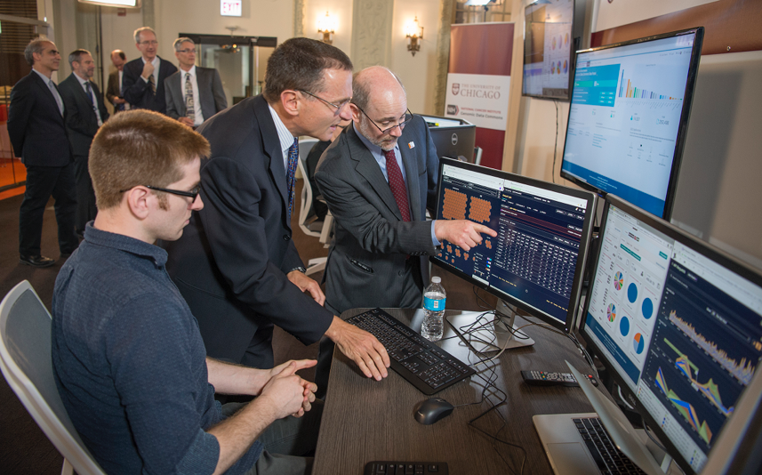
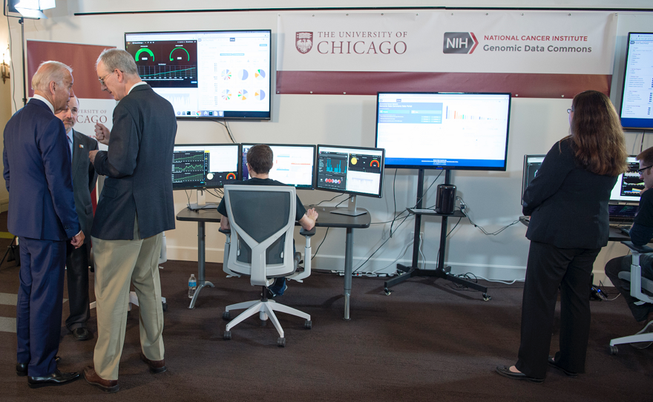
Notes:
The GDC took two years to develop and went live on June 6, 2016 through an announcement by VP Biden at the American Society for Clinical Oncologists

Slide 46
The Cancer Genomic Data Commons (GDC) is an existing effort to standardize and simplify submission of genomic data to NCI and follow the principles of FAIR – Findable, Accessible, Attributable, Interoperable, Reusable, and Provide Recognition.
The GDC is part of the NIH Big Data to Knowledge (BD2K) initiative and an example of the NIH Commons
Genomic Data Commons
Microattribution, nanopublications, tracking the use of data, annotation of data, use of algorithms, supports the data /software /metadata life cycle to provide credit and analyze impact of data, software, analytics, algorithm, curation and knowledge sharing
Force11 white paper
https://www.force11.org/group/fairgroup/fairprinciples
Notes:
The GDC is the Foundation of a Cancer Knowledge System

Slide 47
NCI Genomic Data Commons
The GDC went live on June 6, 2016 with approximately 4.1 PB of data
This includes:
  2.6 PB of legacy data
  1.5 PB of “harmonized” data
577,878 files about 14,194 cases (patients), in 42 cancer types, across 29 primary sites
10 major data types, ranging from Raw Sequencing Data, Raw Microarray Data, to Copy Number Variation, Simple Nucleotide Variation and Gene Expression
Data are derived from 17 different experimental strategies, with the major ones being RNA-Seq, WXS, WGS, miRNA-Seq, Genotyping Array and Expression Array
Foundation Medicine announced the release of 18,000 genomic profiles to the GDC at the Cancer Moonshot Summit

Slide 48
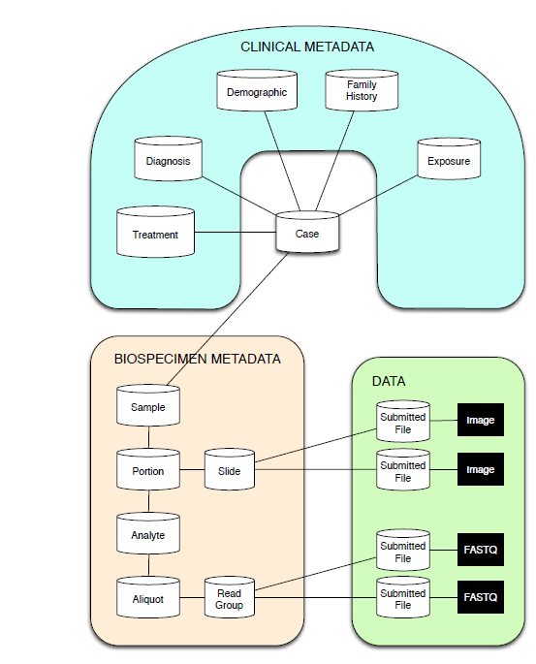
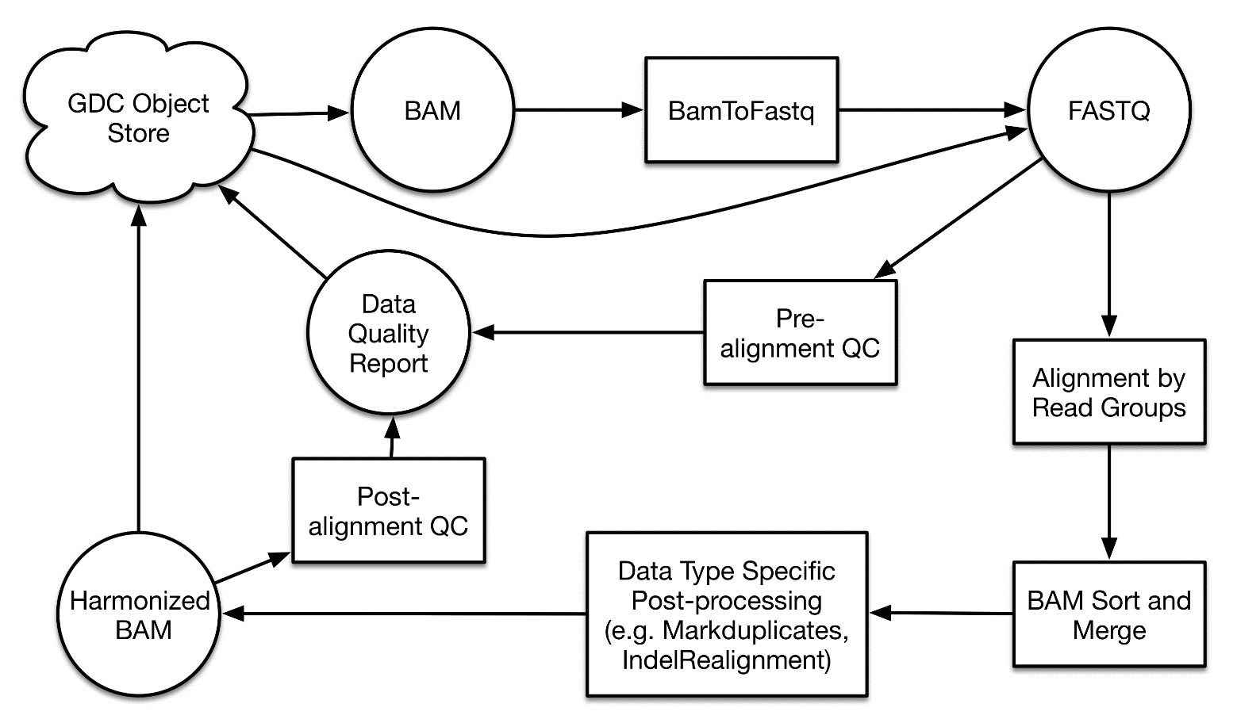
GDC: Data Submission & Harmonization
Data Submission
Data Harmonization
https://gdc.cancer.gov/
Notes:
upload their data to a workspace within the GDC and validate using Data Submission Tools
GDC supports data standards for biospecimens, clinical, and molecular data, based upon the TCGA data model
runs harmonization pipeline based on Broad's Firehose to map BAMs to the genome and call variants

Slide 49
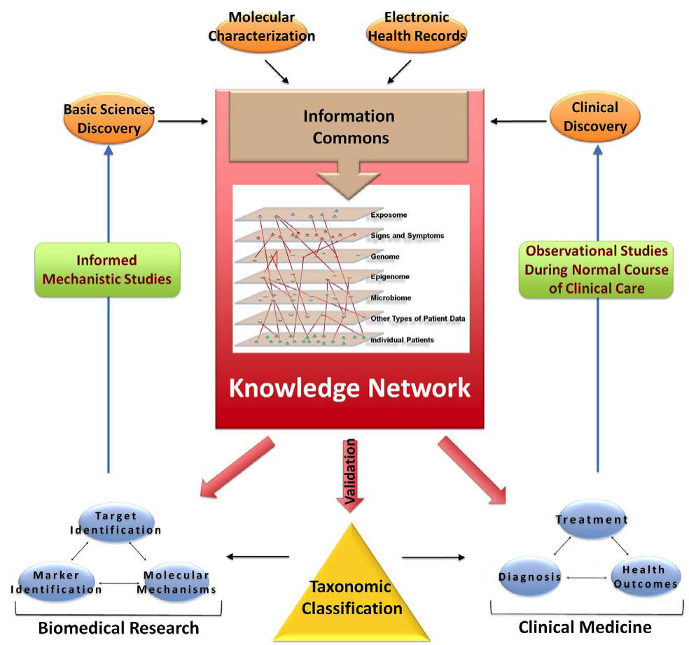

Development of the NCI Genomic Data Commons (GDC)
To Foster the Molecular Diagnosis and Treatment of Cancer
GDC
Bob Grossman PI
Univ. of Chicago
Ontario Inst. Cancer Res.
Leidos
Institute of Medicine
Towards Precision Medicine
2011
Notes:
The GDC will help inform that molecular classification of disease, and contribute to the new taxonomy of cancer.

Slide 50
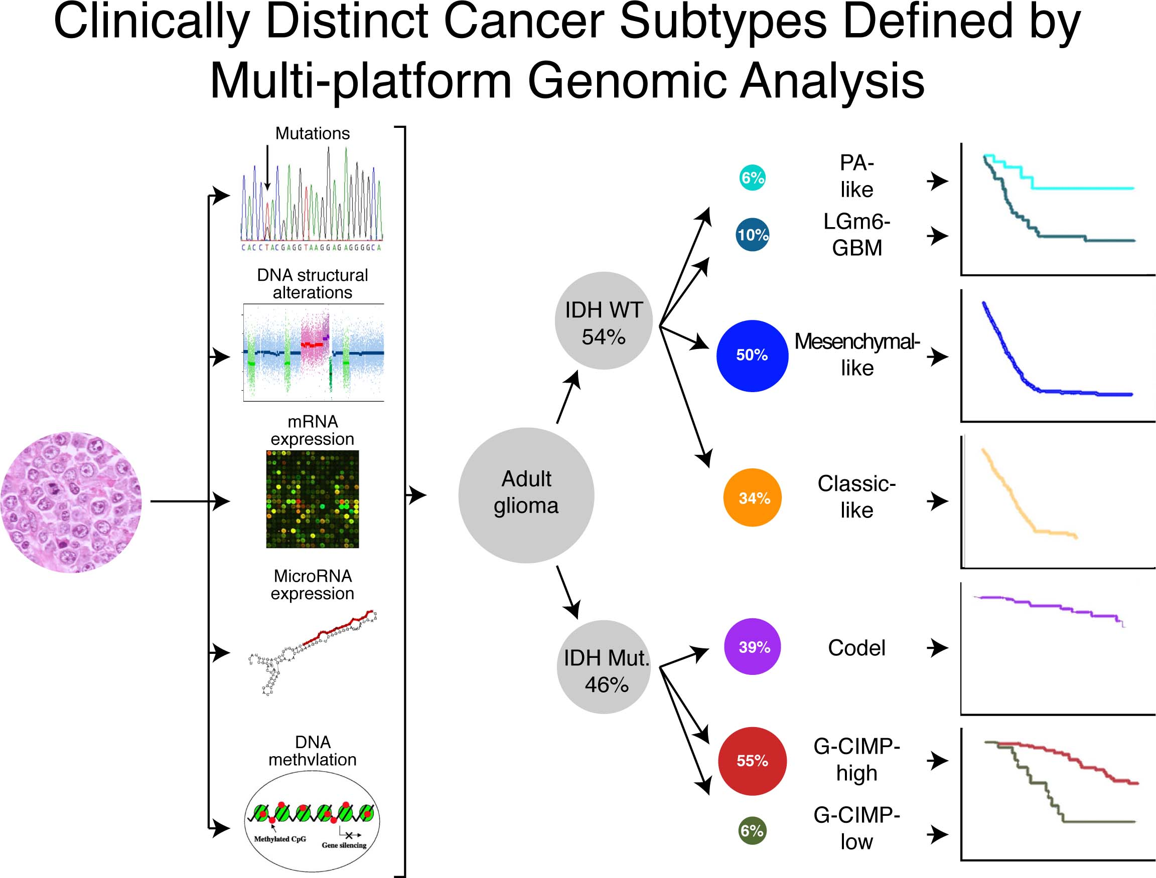

Slide 51
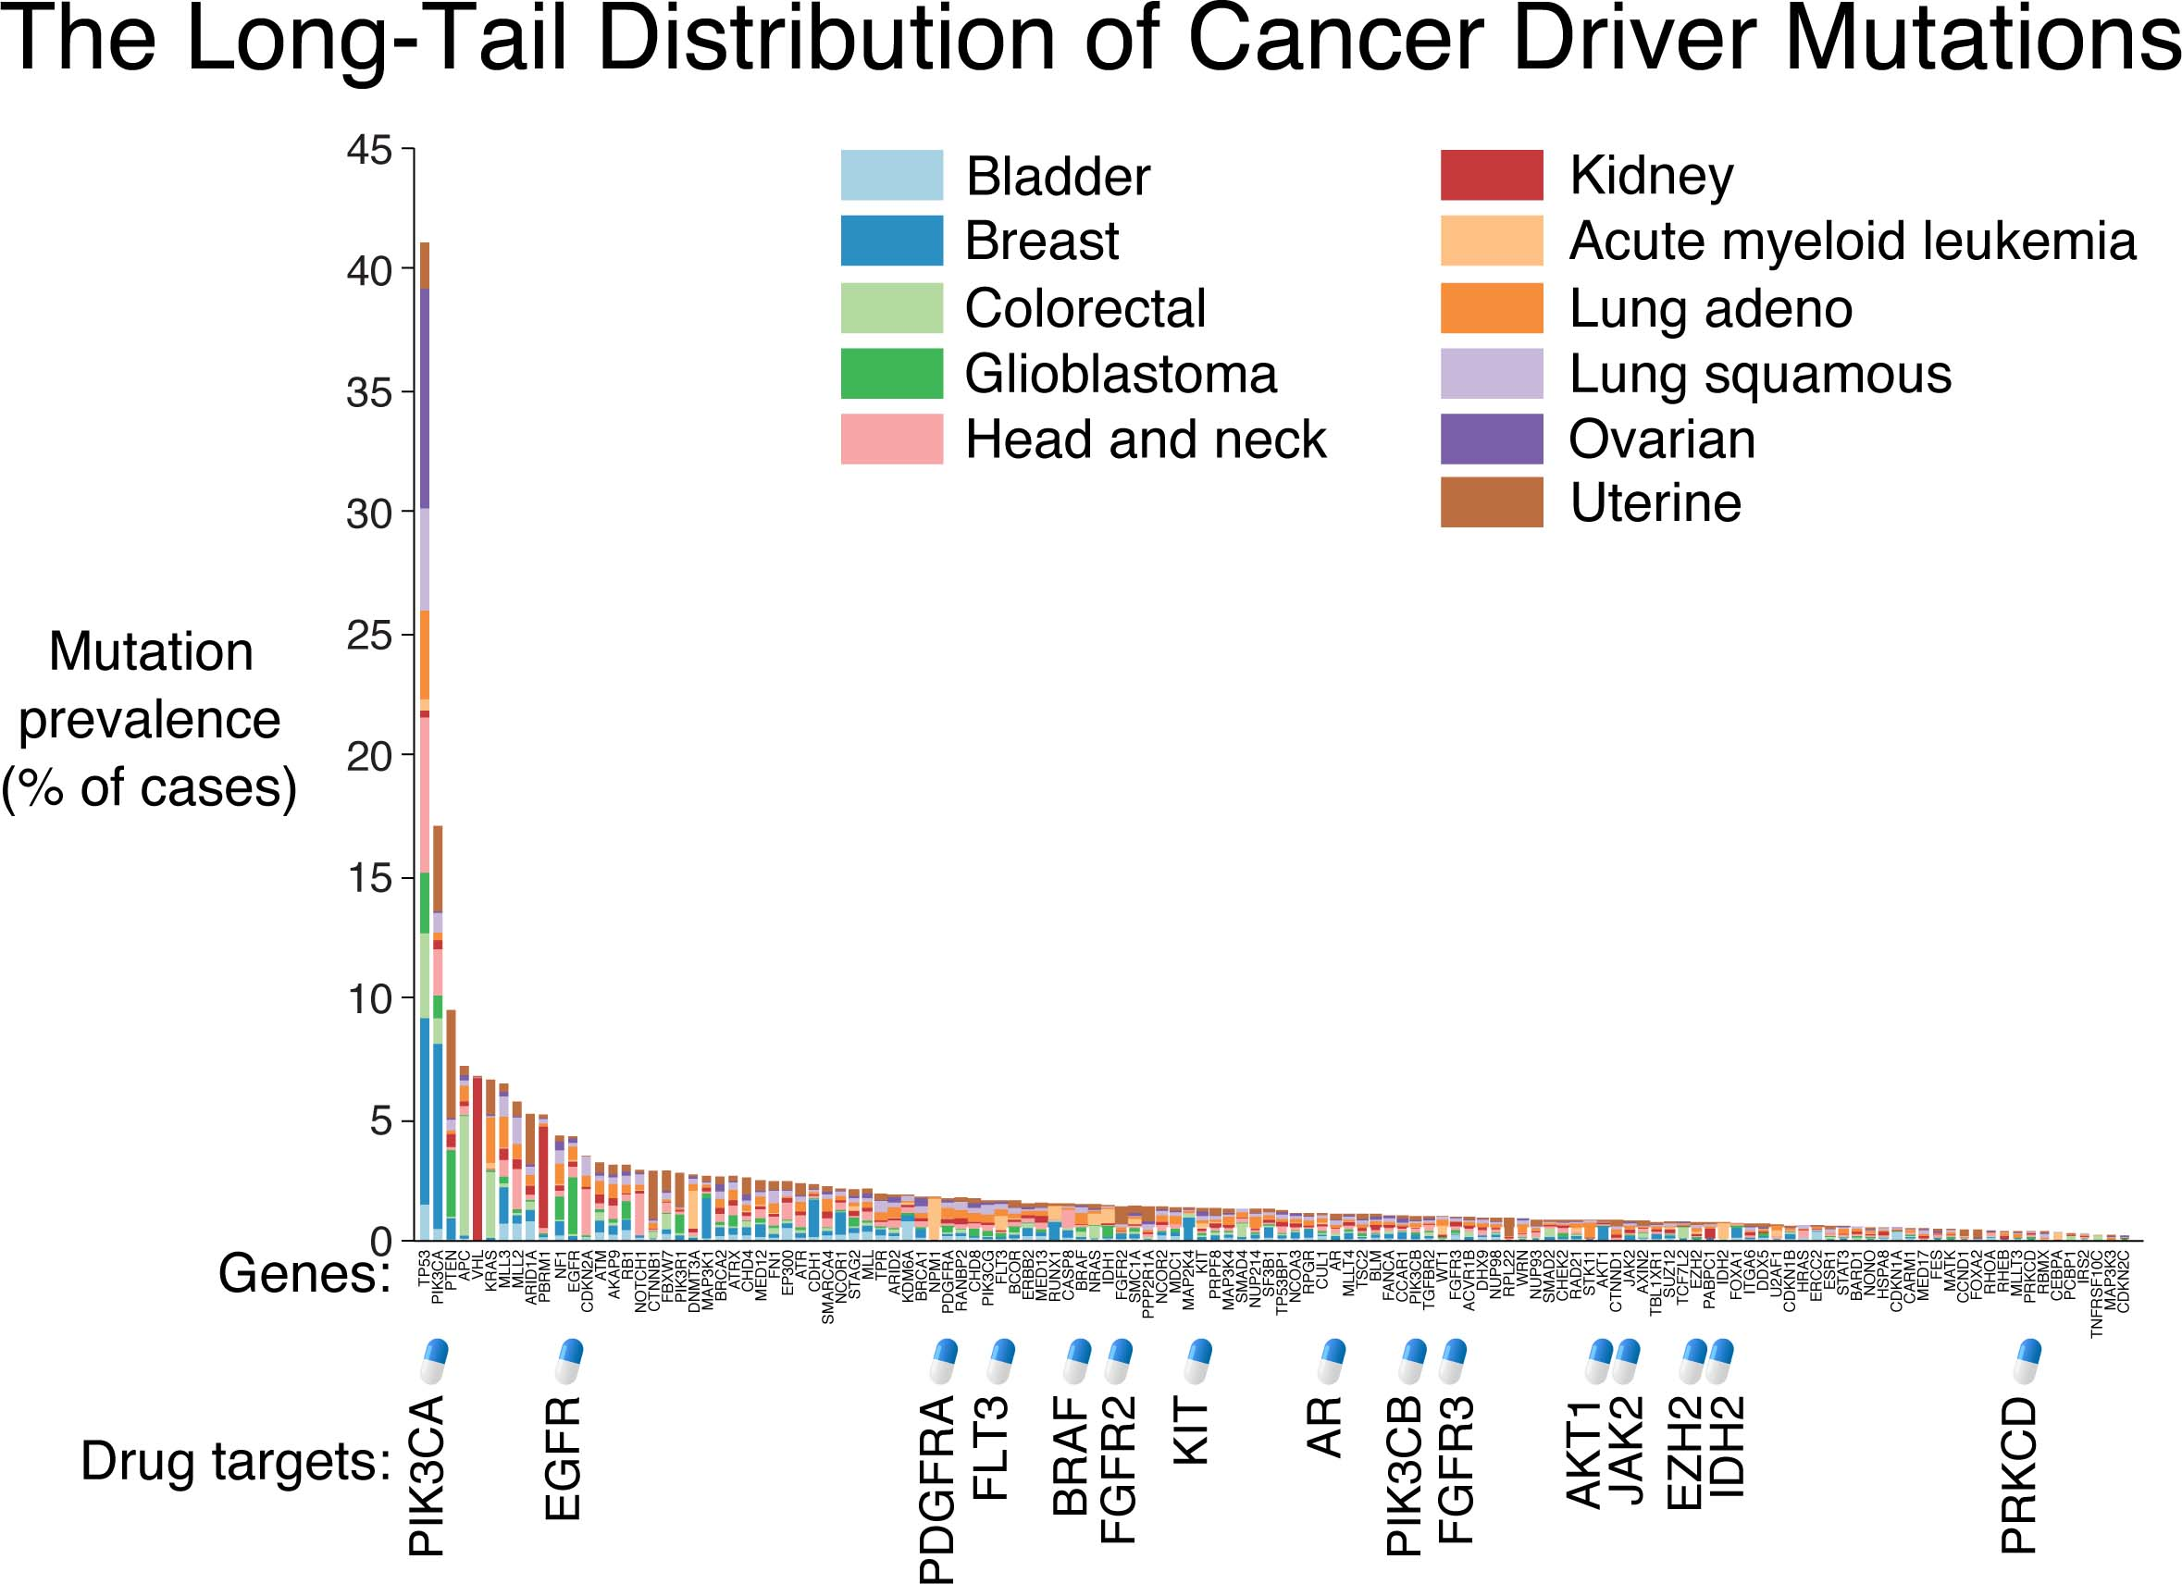

Slide 52
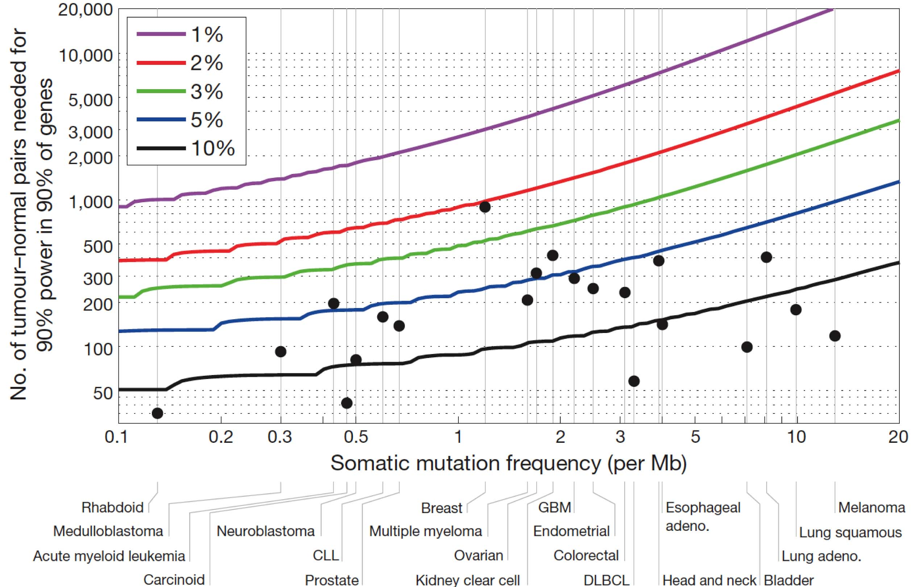
Discovery of Cancer Drivers With 2% Prevalence
Power Calculation for Cancer Driver Discovery
Need to resequence >100,000 tumors to identify all cancer drivers at >2% prevalence
Ovarian
+ 500
Colorectal
+ 1,200
Lung adeno.
+ 2,900
Lawrence et al, Nature 2014

Slide 53
The NCI Cancer Genomics
Cloud Pilots
Understanding how to meet the research community’s need to analyze large-scale cancer genomic and clinical data

Slide 54
NCI Cancer Genomics Cloud Pilots
Cloud Pilots provide:
Access to large genomic data sets without need to download
Access to popular pipelines and visualization tools
Ability for researchers to bring their own tools and pipelines to the data
Ability for researchers to bring their own data and analyze in combination with existing genomic data
Workspaces, for researchers to save and share their data and results of analyses
Democratize access to NCI-generated genomic and related data, and to create a cost-effective way to provide scalable computational capacity to the cancer research community.
Notes:
These pilots were initiated three years ago based on our awareness that the traditional model of data download and management by every research group was no longer scalable; the NCI wanted to explore the effectiveness of co-locating data and compute in a cloud environment for access and analysis. The overall goals is to…..
While meeting strict federal security guidelines

Slide 55
Three NCI Genomics Cloud Pilots
Broad Institute
Google Cloud
Institute for Systems Biology
Google Cloud
Leverage Google infrastructure; Novel query and visualization
Seven Bridges Genomics
Amazon Web Services
Interactive data exploration; > 30 public pipelines
http://firecloud.org
http://cgc.systemsbiology.net/
http://www.cancergenomicscloud.org
PI: Gad Getz
PI: Ilya Shmulevich
PI: Deniz Kural
Firehose in the cloud including Broad best practices workflows
Selection
Design/Build I
Design/Build II
Evaluation
Extension
Jan 2014
Sept 2014
April 2015
Jan 2016
Sept 2016
Notes:
We initiated three cloud pilots to promote innovation so that multiple frameworks and architectures could be explored.

Slide 56
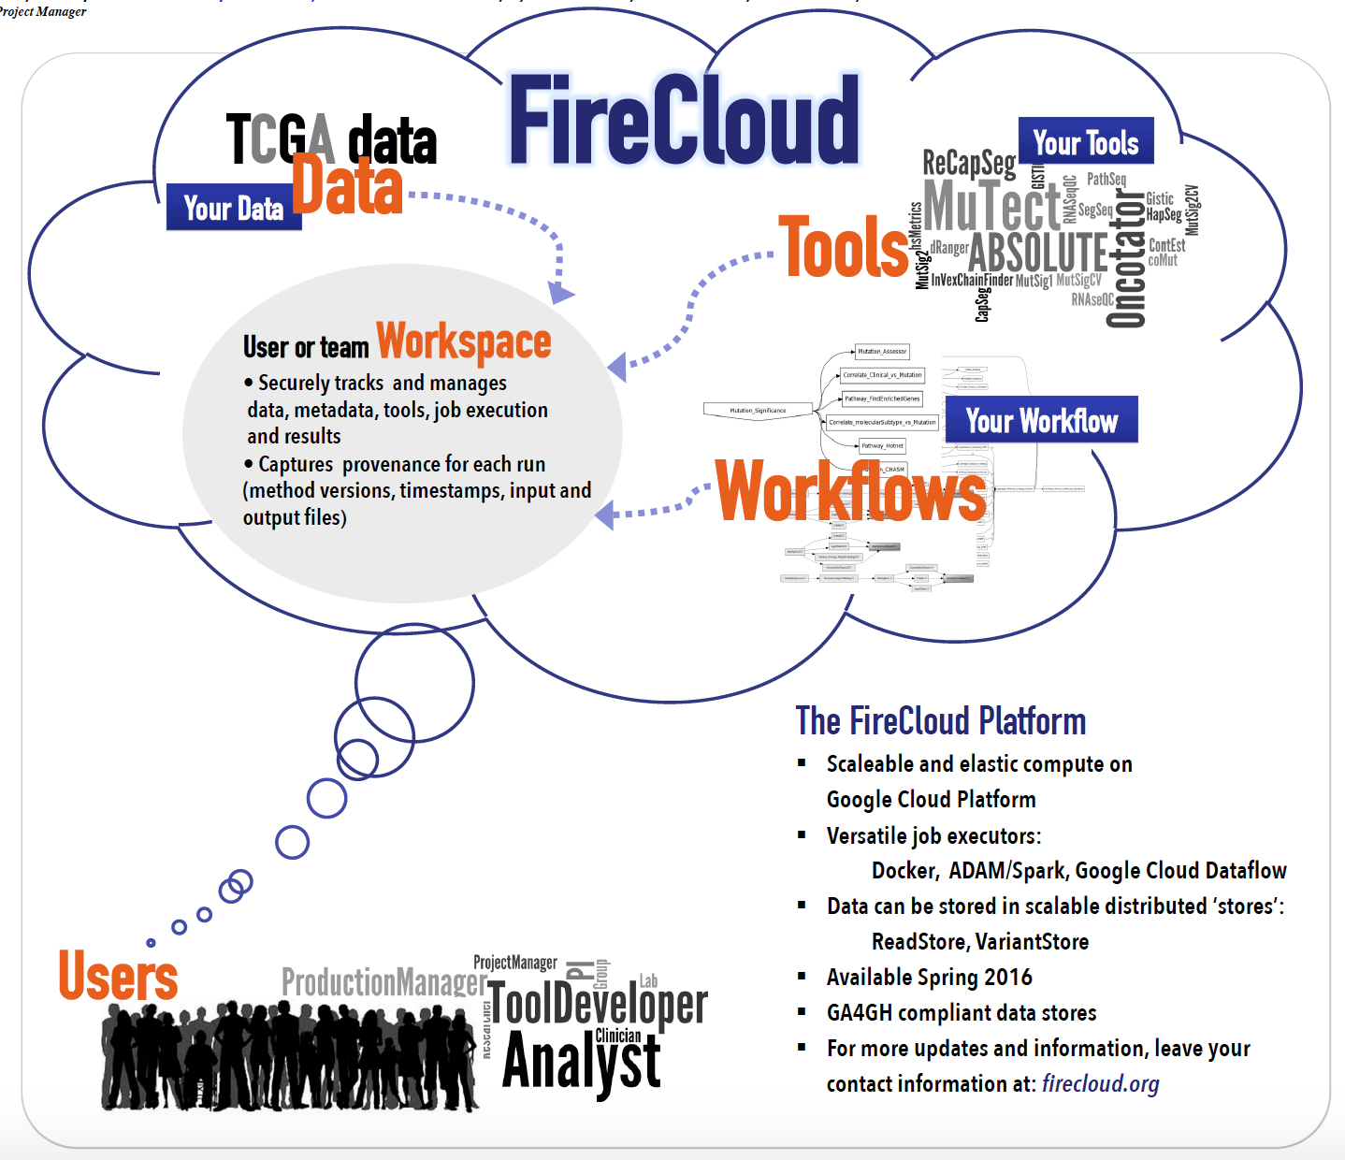
Broad Institute Cloud Pilot
Targeted at users performing analyses at scale
Modeled after their Firehose analysis infrastructure developed for the TCGA program
Users can upload their own data and tools and/or run the Broad’s best practice tools and pipelines on pre-loaded data

Slide 57





Institute for Systems Biology Cloud Pilot
  Closely tied with Google Cloud Platform tools including BigQuery, App Engine, Cloud Datalab, Google Genomics, and Compute Engine
  Aggregated TCGA data in BigQuery allows fast SQL-like queries across the entire dataset
  Web interface allows scientists to interactively compare and define cohorts
PI / Biologist
web access
Computational Research Scientist
Python, R, SQL
Algorithm Developer
ssh, programmatic access
Local Storage
ISB-CGC Web App
Google Cloud Console
ISB-CGC APIs
Google APIs
Cloud
Storage
BigQuery
Genomics
Compute Engine VMs
ISB-CGC
Hosted Data
Controlled-Access Data
User Data
Open-Access Data

Slide 58
Seven Bridges Genomics Cloud Pilot
Built upon the SBG commercial cloud-based genomics platform
Graphical query interface to identify hosted data of interest
Includes a native implementation of the Common Workflow Language specification and graphical interface for creating user-defined workflows

Slide 59
Workspace – isolated environment for collaborative analysis
sample data and metadata (e.g. BAMs, tissue type)
algorithms
(e.g. mutation calling)
Data + Methods → Results
Wiring logic
(e.g. use the exome capture BAM)
executions and results
(e.g. run mutation caller v41 on this exact bam and track results)
Slide courtesy of Broad Institute
Notes:
Firecloud provides a personal “sandbox” for analysis of genomic data
Holds data, workflows, results
Robust security
Supports collaboration through user-controlled access
Workspaces can be shared
Provenance can be captured for every analysis run (ie: what version of what method was run on what data at what time)

Slide 60
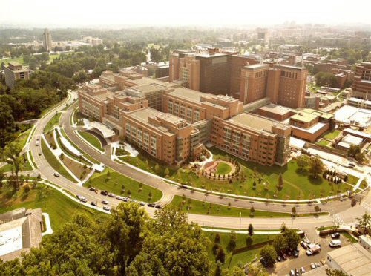
GDC Acknowledgements
NCI Center for Cancer Genomics
Univ. of Chicago
Bob Grossman
Allison Heath
Mike Ford
Zhenyu Zhang
Lou Staudt
Zhining Wang
Martin Ferguson
JC Zenklusen
Daniela Gerhard
Deb Steverson
Ontario Institute for Cancer Research
NCI NCI CBIIT
Tony Kerlavage
Tanya Davidsen
Vincent Ferretti
'Francois Gerthoffert
JunJun Zhang
Leidos Biomedical Research
Mark Jensen
Sharon Gaheen
Himanso Sahni

Slide 61
Cancer Genomics Project Teams
CGC Pilot Team Principal Investigators
  Gad Getz, Ph.D - Broad Institute - http://firecloud.org
  Ilya Shmulevich, Ph.D - ISB - http://cgc.systemsbiology.net/
  Deniz Kural, Ph.D - Seven Bridges – http://www.cancergenomicscloud.org
NCI Project Officer & CORs
  Anthony Kerlavage, Ph.D –Project Officer
  Juli Klemm, Ph.D – COR, Broad Institute
  Tanja Davidsen, Ph.D – COR, Institute for Systems Biology
  Ishwar Chandramouliswaran, MS, MBA – COR, Seven Bridges Genomics
GDC Principal Investigator
  Robert Grossman, Ph.D - University of Chicago
  Allison Heath, Ph.D - University of Chicago
  Vincent Ferretti, Ph.D - Ontario Institute for Cancer Research
Center for Cancer Genomics Partners
  JC Zenklusen, Ph.D.
  Daniela Gerhard, Ph.D.
  Zhining Wang, Ph.D.
  Liming Yang, Ph.D.
  Martin Ferguson, Ph.D.
NCI Leadership Team
  Doug Lowy, M.D.
  Lou Staudt, M.D., Ph.D.
  Stephen Chanock, M.D.
  George Komatsoulis, Ph.D.
  Warren Kibbe, Ph.D.

Slide 62
Integrated data sets, interoperable resources, harmonized data are necessary for and enable biologically informed cancer computational predictive models

Slide 63

Questions?
Warren Kibbe, Ph.D.
Warren.kibbe@nih.gov
@wakibbe

Slide 65
NIH Genomic Data Sharing Policy https://gds.nih.gov/
Went into effect January 25, 2015
NCI guidance: http://www.cancer.gov/grants-training/grants-management/nci-policies/genomic-data
Requires public sharing of genomic data sets

